Slide 1
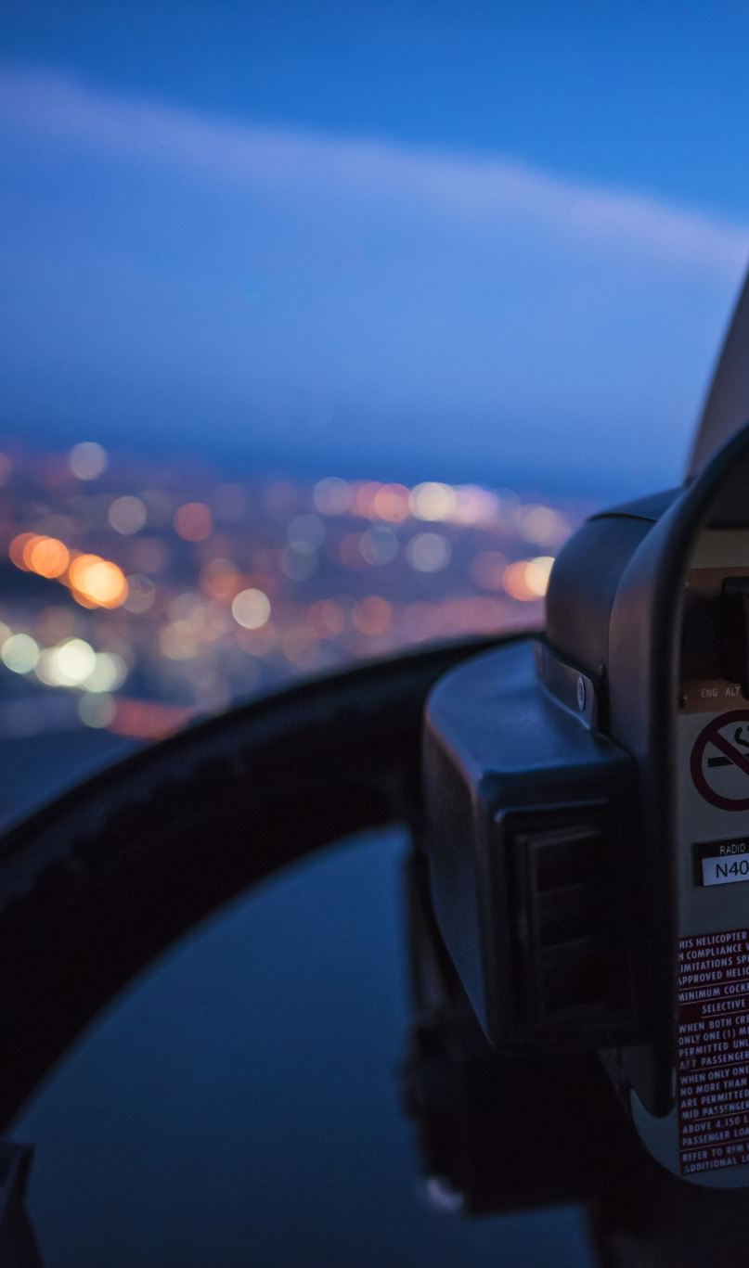
NTU Ride Pilot
Presented by: Abubakar Nadeem, Imran Ali Niaz, Huzaifa Ahmad
Supervised by: Mr. Zahid Javed, Mr. Muhammad Naeem
Institution: National Textile University, Faisalabad

Slide 2
Table of Contents
Problem Statement
Proposed Solution
Key Features
Real-Time ID Verification
Live GPS Tracking
Overcrowding and Underutilization Alerts
Driver Efficiency Monitoring
Technology Stack
Expected Outcomes
Conclusion

Slide 3
1. Problem Statement
Inefficient transport in educational institutions
No real-time tracking or monitoring
Overcrowding and unauthorized access
Poor communication between administration, students, parents

Slide 4
2. Proposed Solution
RFID-based student verification system
Real-time GPS tracking of buses
Mobile & web-based solution for all stakeholders
Notification system for delays and emergencies
Driver & occupancy monitoring

Slide 5
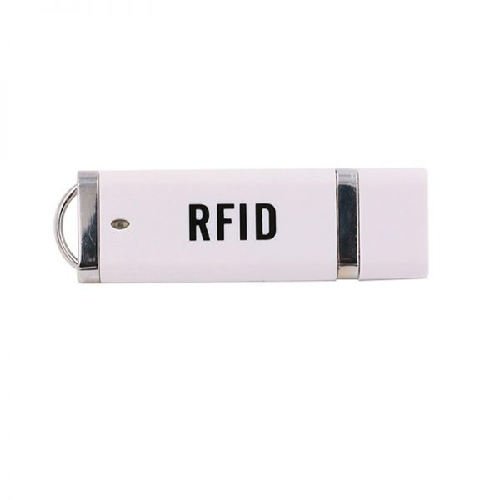
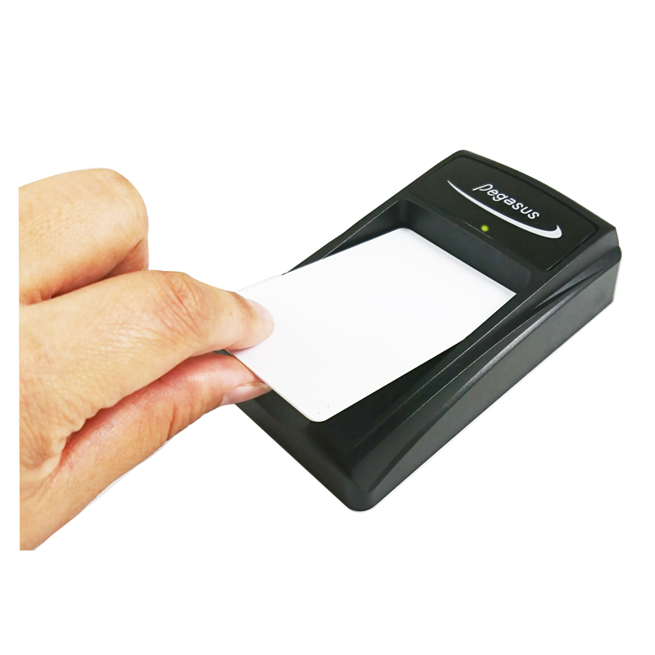
3. Key Features
RFID Authentication
Live GPS Tracking
Mobile App (Student/Driver)
Web Dashboard (Admin)
Real-Time Alerts & Notifications
Route & Ride Management
Bus Card & Session Management
Complaint & Announcement Modules

Slide 6
4. Technology Stack
Flutter (Mobile App)
Next.js (Admin Panel)
Firebase (Auth, DB, Storage)
Mapbox (Live Tracking)
Firebase Cloud Messaging (Notifications)
Firestore (NoSQL Database)

Slide 7
5. Expected Outcomes
Improved safety and transparency
Reduced waiting time & unauthorized access
Efficient admin controls & reporting
Higher trust from students and parents
Scalable to other institutions or public systems

Slide 8
6. Conclusion
NTU Ride Pilot is a smart transport management system
Ensures safety, efficiency, and real-time control
Addresses real campus transport problems
Ready for deployment and future upgrades

